Slide 1


Logrotate
Logs are rotated by the logrotate utility to keep them from filling up the file system containing /var/log.
When a log file is rotated, it is renamed with an extension indicating the date on which it was rotated.
The old /var/log/messages file may become /var/log/messages-20240516 if it is rotated on May 16 2024.Once the old log file is rotated, a new log file is created and the service that writes to it is notified.

Slide 2
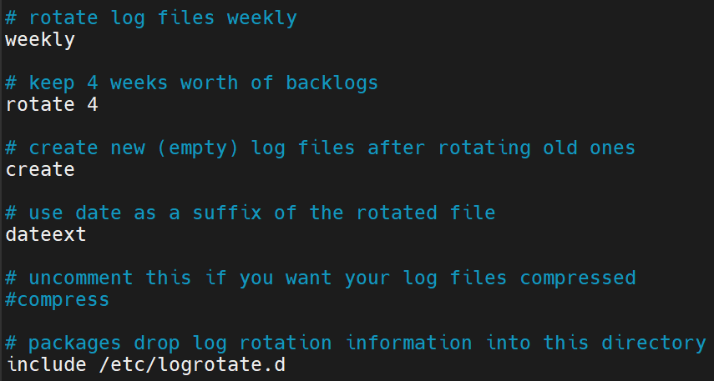
Logrotate directives
Config file: /etc/logrotate.conf

Slide 3
Custom logrotate configuration
login as root: sudo su -
vim /etc/logrotate.d/syslogs
/var/log/syslog/ip-172-31-26-63/*.log {
rotate 4
weekly
create
missingok
compress
}

Slide 4
Example
vim /etc/logrotate.d/syslogs
/var/log/syslog/ip-172-31-26-63/*.log {
daily
size 1M
compress
}

Slide 5
Example (contd.)
cd /var/log/syslog/ip-172-31-26-63/
fallocate -l 2M file22.log
Debug mode: logrotate -d /etc/logrotate.conf
Manual execution: logrotate /etc/logrotate.conf
logrotate trigger time: systemctl status logrotate.timer
More options/information: man logrotate

